Slide 1
Hello
And welcome to our
Presentation

Slide 2
Presented by
Shafiul Islam Joy ID:1702005
Antor Shaha ID:1702006
Md. Hasibul Hasan Chowdhury ID:1702007
Iasin Arafat ID: 1702008
Department of Electrical and Electronics Engineering

Slide 3
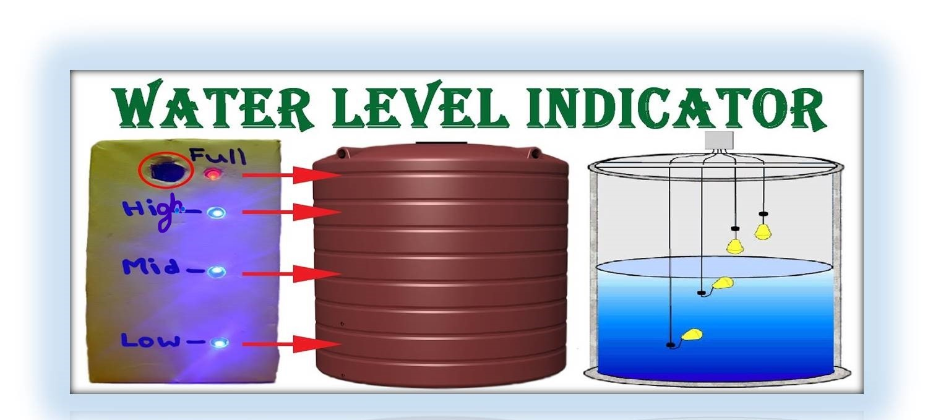
we are presenting on
Water level indicator with alarm !!

Slide 4
Introduction
The water level alarm circuit is a simple mechanism to detect and indicate the level of water in the overhead tank and also in the other containers.
The sensing is done by sets of three probes which are sets at three different levels on the tank walls .

Slide 5
Components
Transistors BC547
150Ω Resistor
Buzzers/LED
9V supply
Bread Board
LED’s (Different Colors)
Connecting Wires

Slide 6
Brief notes of some of the components we use
Bread Board :A board for making an experimental model of an electric circuit.
Transistor: In this circuit we use BC547 transistor , which is very common emitter NPN transistor and its basically used for the amplification and switching purpose .
Buzzer :It produces sound actual use for the alarm circuit.
LED :A LED is a two lead semiconductor light source , is a p-n junction diode , emits light when activated

Slide 7
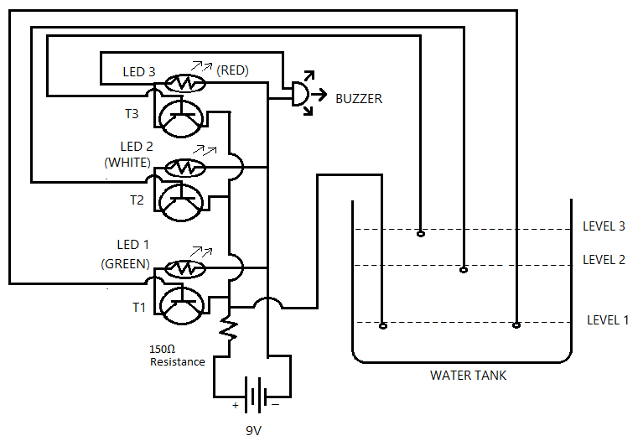
Circuit Diagram

Slide 8
Working principle
The operation of the project is very simple and can be understood very easily. In our project “ Water level indicator” there are three main conditions:
There is no water or very less water available in the source tank. Intermediate level.
There is ample amount of water available in the source tank or about to overflow.
So let us discuss on the more about these three condition.

Slide 9
Working principle
After establishing the the required connection as shown in the circuit diagram , we place the other ends of the three wires which are connected to the base of the three transistors into a bowl at three different levels of height.
Suppose wire 1 is at a lower height.
Wire 2 is at a medium height.
Wire 3 is at a height from which water is supposed to overflow.

Slide 10
Working principle
As we start pouring water into the bowl, the water level touches the first (wire 1) which is at a lower height and the circuit gets completed and currents starts flowing and the first LED (D1) glows.
Gradually, as the level of water goes on increasing the other two LEDs
(D2 and D3 glows) indicating that the water has reached to maximum height.
As the water level crosses the maximum limit, the buzzer starts beeping and thus sends an alarm so that we can stop the supply of the water.
Thus, this simple circuit depicts how a simple water level indicator help us in preventing the flow of water and further help us in reducing the wastage of water and power.
So, it turns us to be very useful appliance which can used.

Slide 11
Have a look

Slide 12
Advantages
Power Saver
Money Saver
Automatic
Preventing wastage of water
Reliable Electronic design
Easy Installation with LED monitoring

Slide 13
Disadvantages
Water level controls need to be replaced every 3 years.
The rust, foul and deteriorate
Most float switches are outdated
Unable to handle the high power

Slide 14
Applications and It’s uses
Water tank level control
Automatically turn ON/OFF pumps
Can be used in factories, commercial complexes, apartments, home
Fuel tank level gauging
Oil tank level control
Stream level monitoring
Tsunami warning and sea level monitoring and many more.

Slide 15
To sum up,
This is a simple model water level indicator which can be made at your home.
This project is the solution to help the user to indicate water level in reservoir or into the water tank that indicated different levels in an over head tank.
Finally the project has been successfully implemented and tested , the project gave us more confidence that we will be able to put it in a practice.
Remember,
“Technology is not just a tool , it can give learners a voice that they may not have had before”

Slide 16

Thank you all,
That’s all for now ,any questions?

